Slide 1

Forecasting Cinema Sales
Presented By: Michael Luffred, Ayas Pathoor, Lindsey Munyak, and Aakash Kathirvel

Slide 2
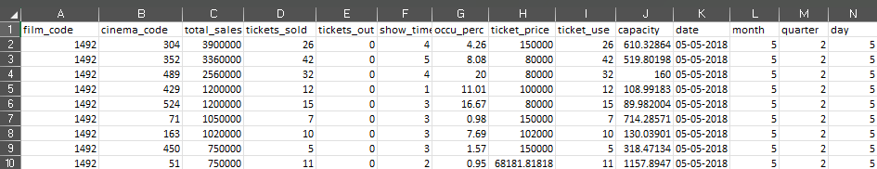
Dataset and its context
This dataset contains daily cinema ticket sales data, aggregated by day and includes various features that influence sales.
Planning inventory
Staffing
Scheduling for the cinema.

Slide 3
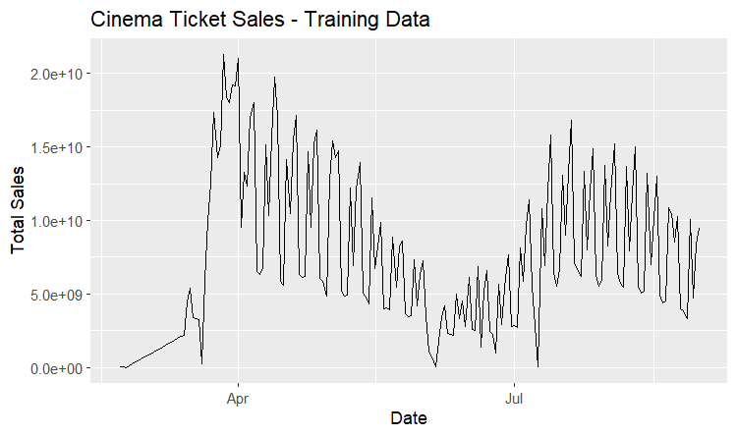
Visualizing Sales Trends and Seasonal Patterns
"The data reveals a clear upward trend in sales over the past year, with particularly strong growth during the holiday season. "The seasonal pattern in ticket sales is evident, with peaks during summer months and dips during winter."

Slide 4
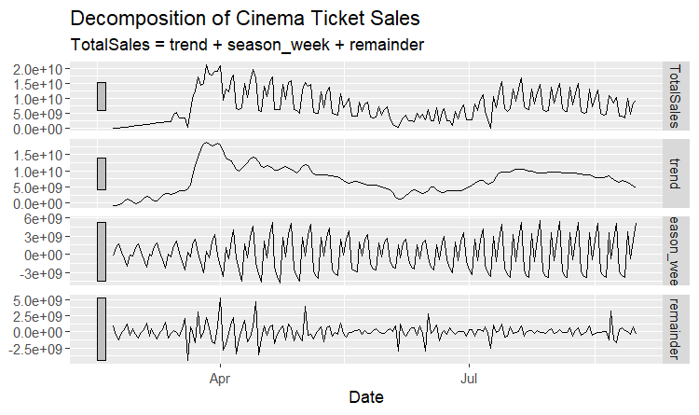

Decomposition of Cinema Ticket : Sales
The decomposition analysis reveals an upward trend in cinema ticket sales over the past year. Due to the limited one-year dataset, subseries and seasonal patterns were not discernible. The random fluctuations in the data are relatively small, suggesting that the overall trend is the primary driver of sales variation.

Slide 5
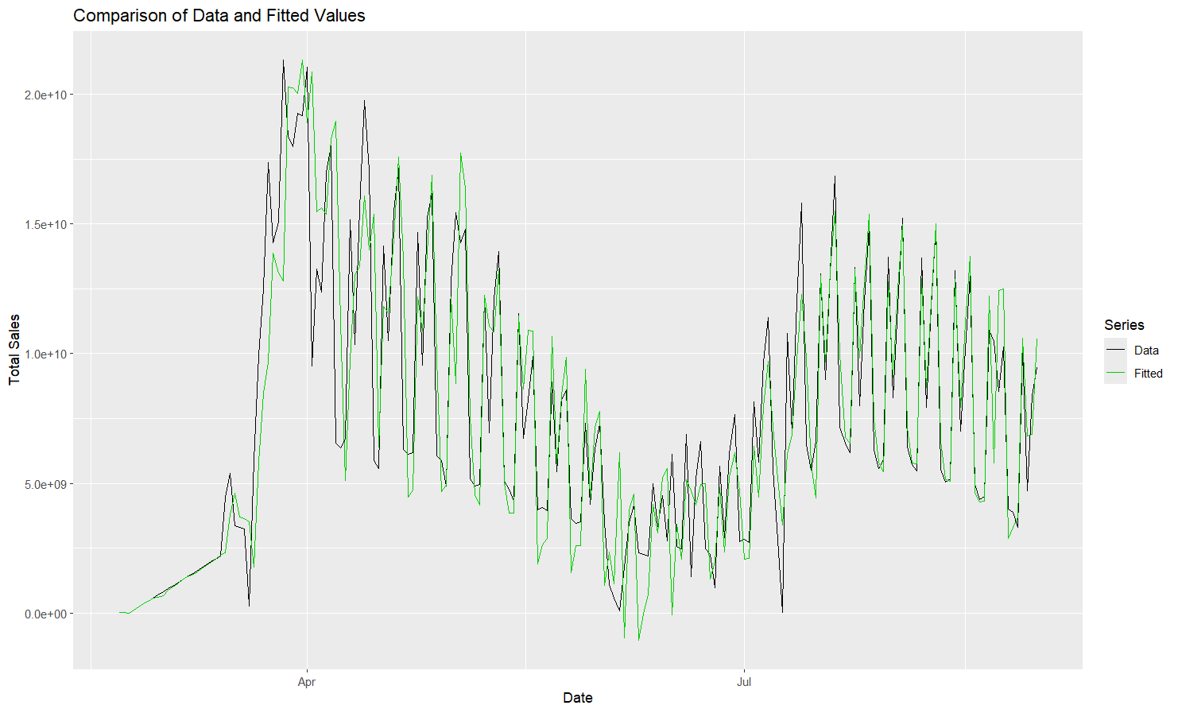
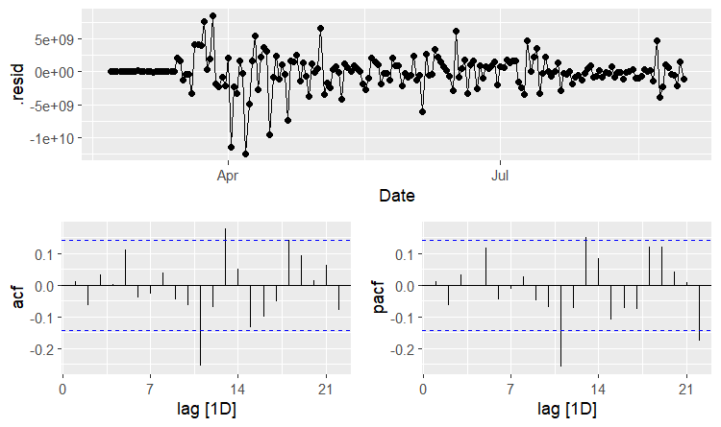
ARIMA MANUAL
here we have one lag , that is uncontrollable , which happen once in a week due to sudden spike because of some other factors.
AIC comes out to be 8510.5

Slide 6
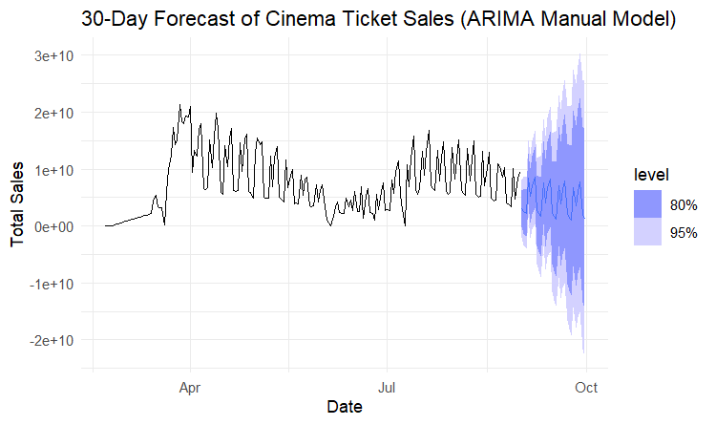
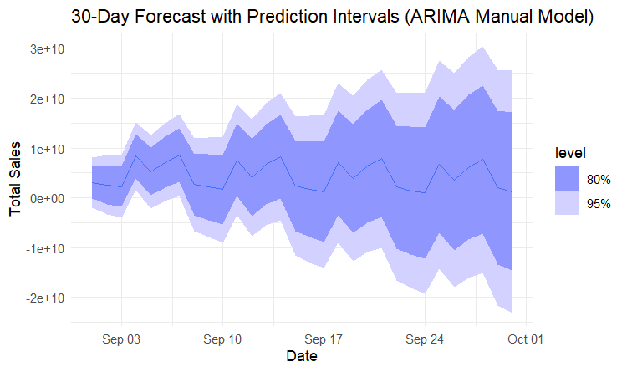
Forecast (ARIMA Manual)

Slide 7
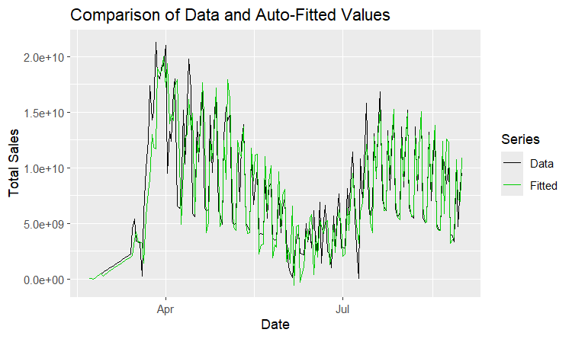
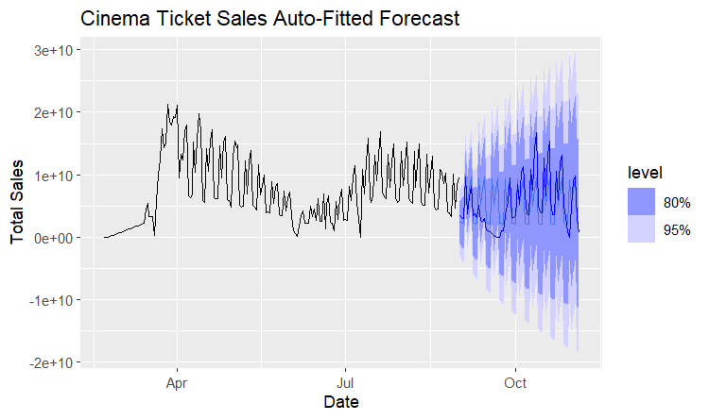

Comparison with Auto ARIMA
The left graph illustrates the fit between data and predictions, while the right graph highlights future forecasts with 80% and 95% confidence levels.
Model: pdq(1,0,2) PDQ (0,1,1)[7]
AIC = 8551.34

Slide 8
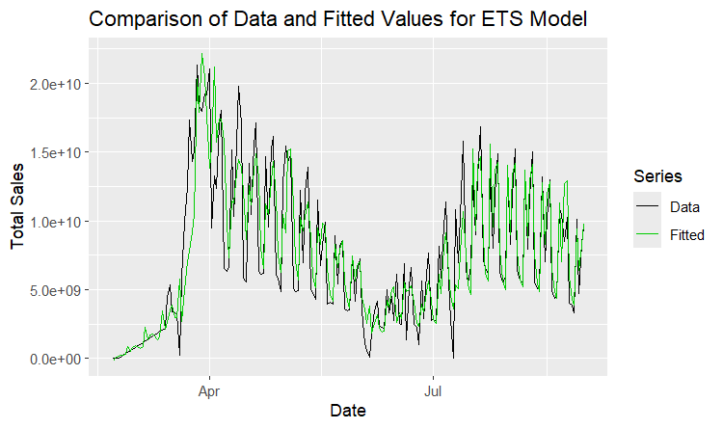
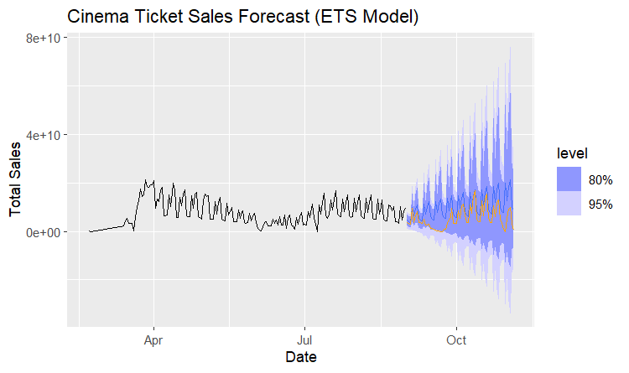
ETS Model-Manual
Model: ETS(M,A,M) This the best model after comparing the AIC of other models ETS (A,A,M) And ETS (A,A,A) and ETS (M,A,A)
AIC = 9266.055

Slide 9
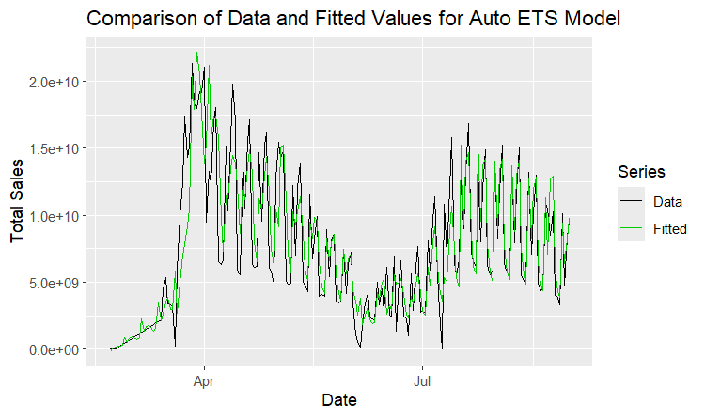
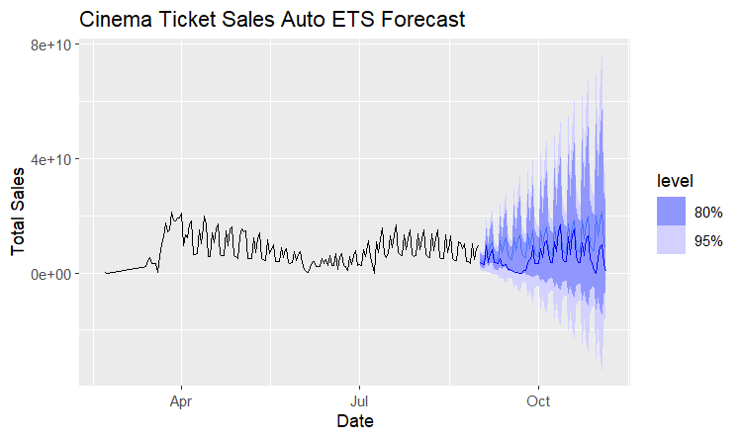
ETS Model-Auto
Model: ETS(M,A,M)
AIC = 9266.055

Slide 10
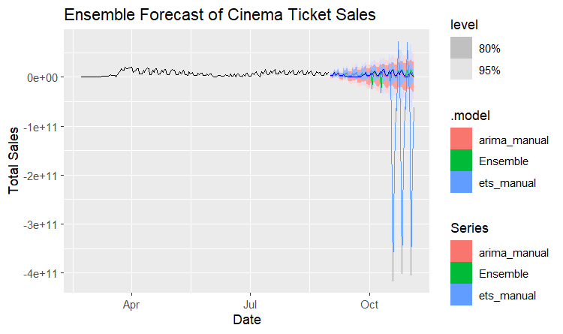
Ensemble Model

Slide 11
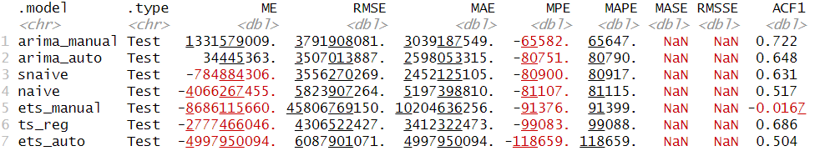
Cross-Validation Results and Final Model Choice
The ARIMA manual model is the best because it achieves the lowest MAPE and RMSE, effectively captures trend and seasonality, produces robust residuals, and delivers accurate, reliable forecasts with narrow confidence intervals

Slide 12
Operational Forecasts
An operational forecast is a predictive analysis designed to support short - medium term decision-making within an organization. It focuses on generating actionable insights to manage daily or weekly operational needs, such as inventory control, staffing, or scheduling, by leveraging historical data and analytical models.

Slide 14
Applications of Analysis
Staffing
Inventory Management
Capacity Utilization
Ensuring sufficient food, drinks, and other concessions based on expected ticket sales
Adjusting showtimes or screens to maximize profitability during high-demand periods
Assigning adequate personnel for peak days or hours.

Slide 15
Thank you !

